Slide 1
Aerodynamic design
In this part trying to build more efficient vehicle which satisfy aerodynamics rules, to achieve requirements:
Mission
Flying taxi which takeoff and landing at streets of the city
Constraints
Max. takeoff weight about 3 Kg.
Max. wide of vehicle 0.8 meter.
Minimum length for easy landing at any place.

Slide 2
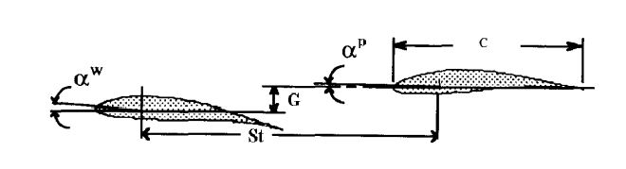
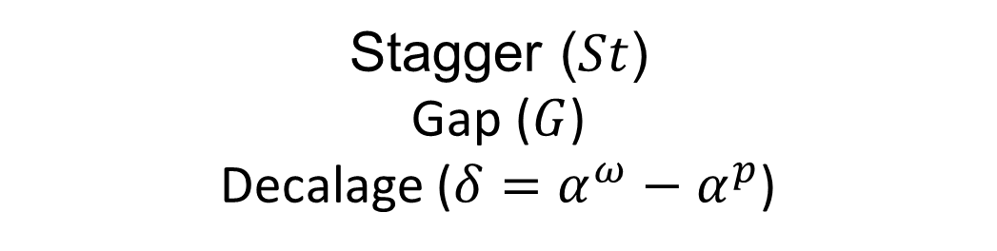
Wing configuration
Design parameters of Tandem wing plane
Stagger ($St$)
Gap ($G$)
Decalage ($δ=α^{ω}−α^{p}$)

Slide 3
Design Criterion

Slide 4
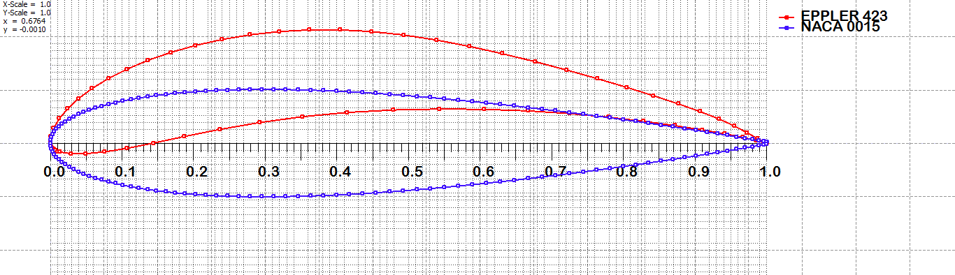
Airfoil selection
Eppler423 (higher lift)
NACA0015 (easy to manufacture)

Slide 5
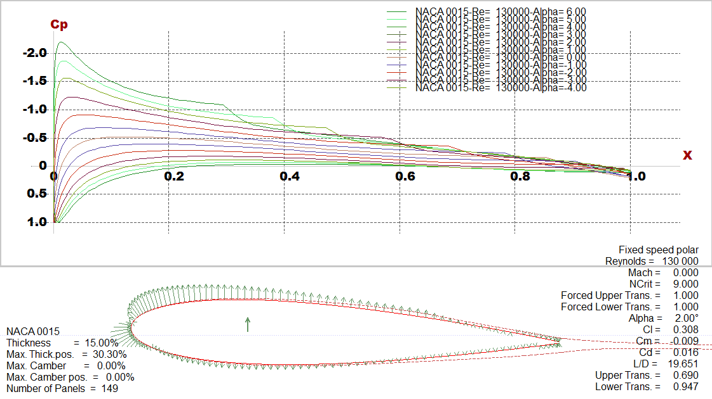
Analyzed airfoils
NACA0015

Slide 6
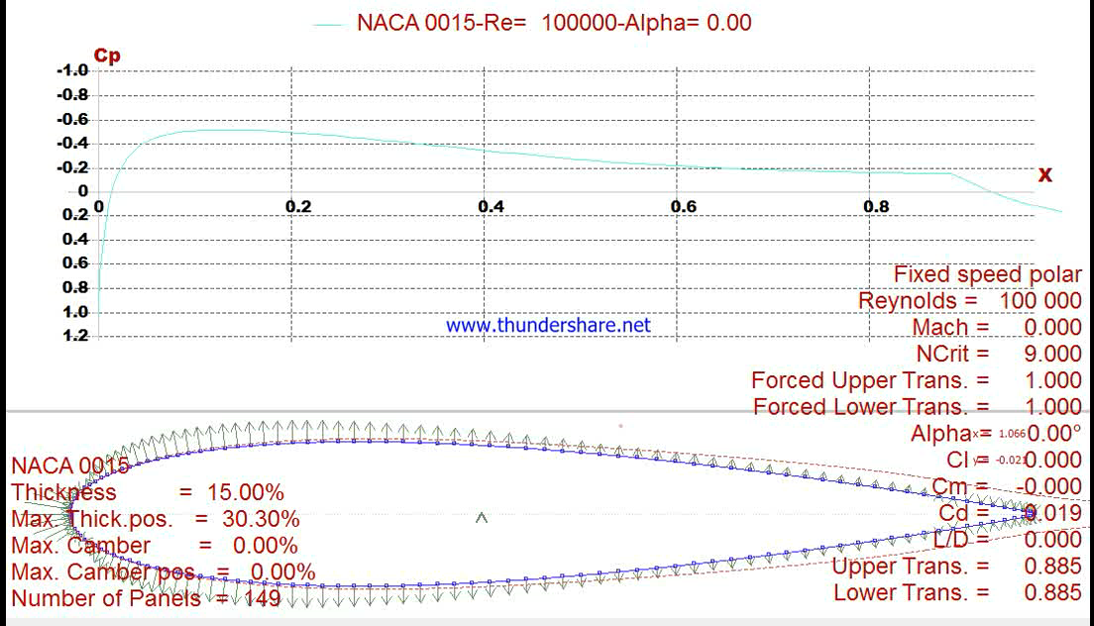

Slide 7
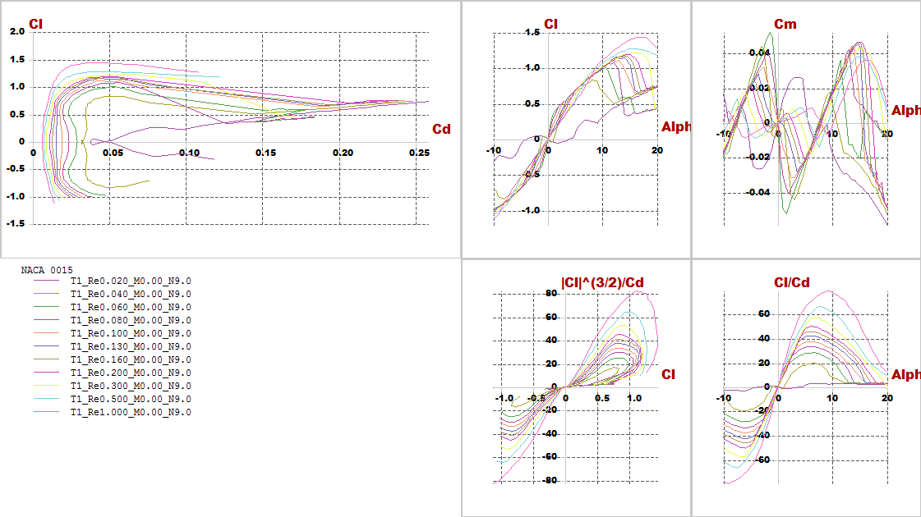
Polar graph with difference Reylonds number

Slide 8
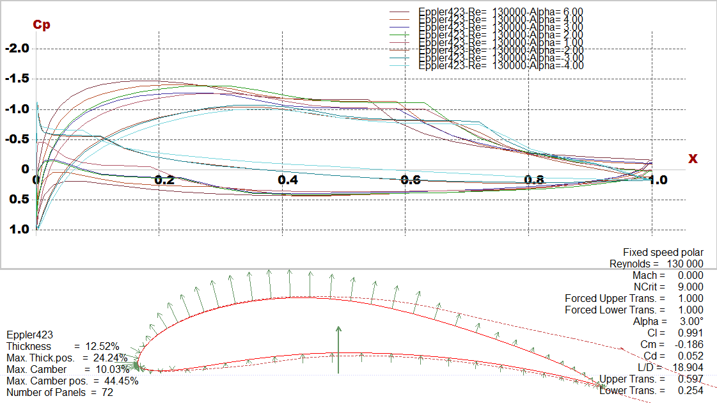
Eppler423

Slide 9
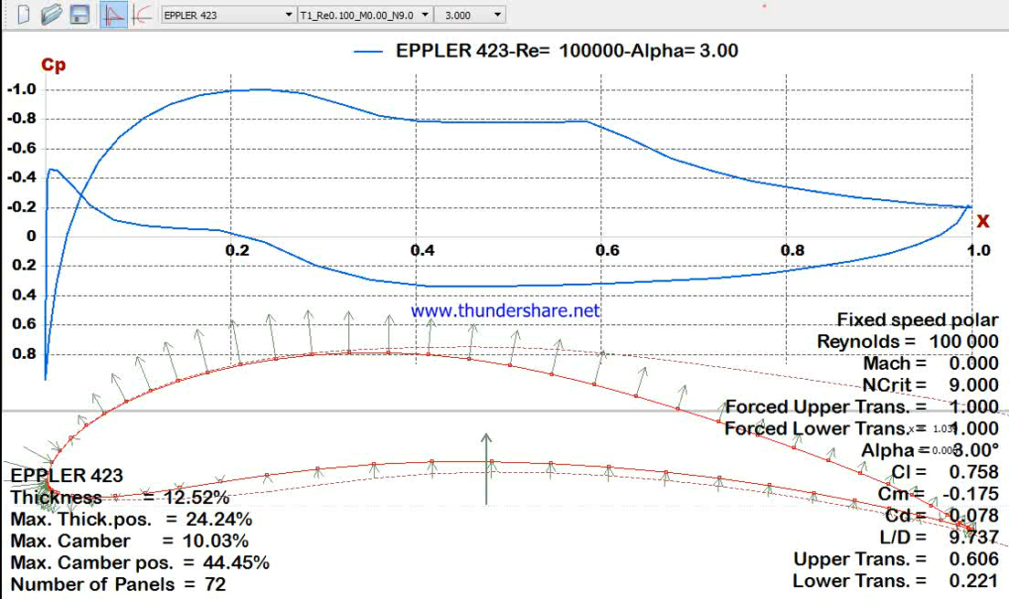

Slide 10
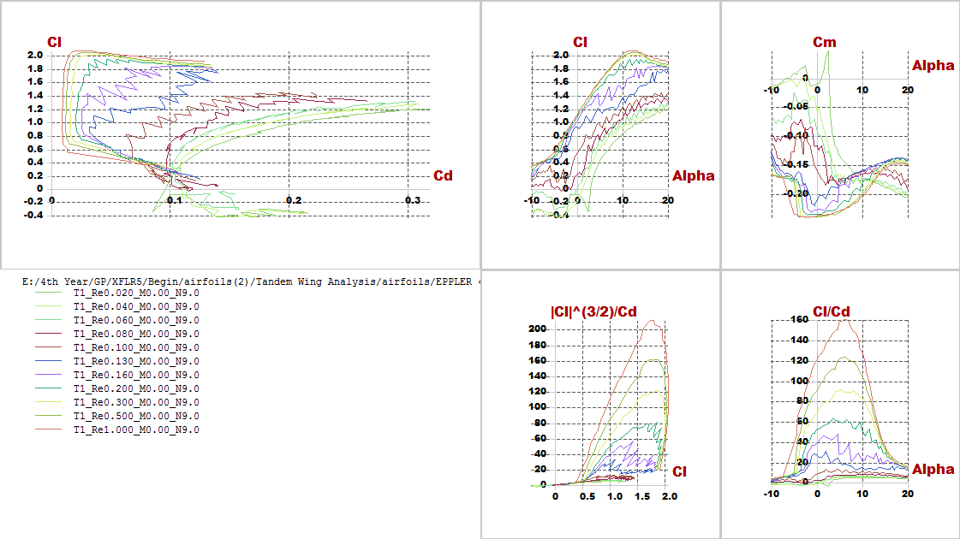
Polar graph with difference Reylonds number

Slide 11
Aerodynamic analysis

Slide 12
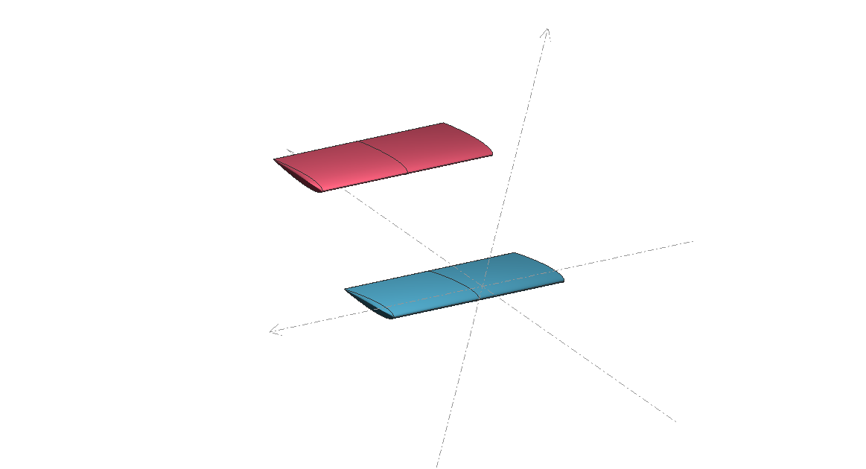
After trying different trials considering constraints and requirements, the best configuration has been chosen then stability and lift produced is

Slide 13
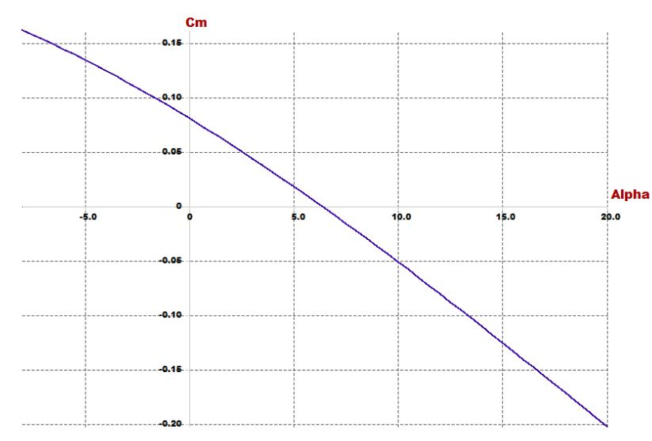
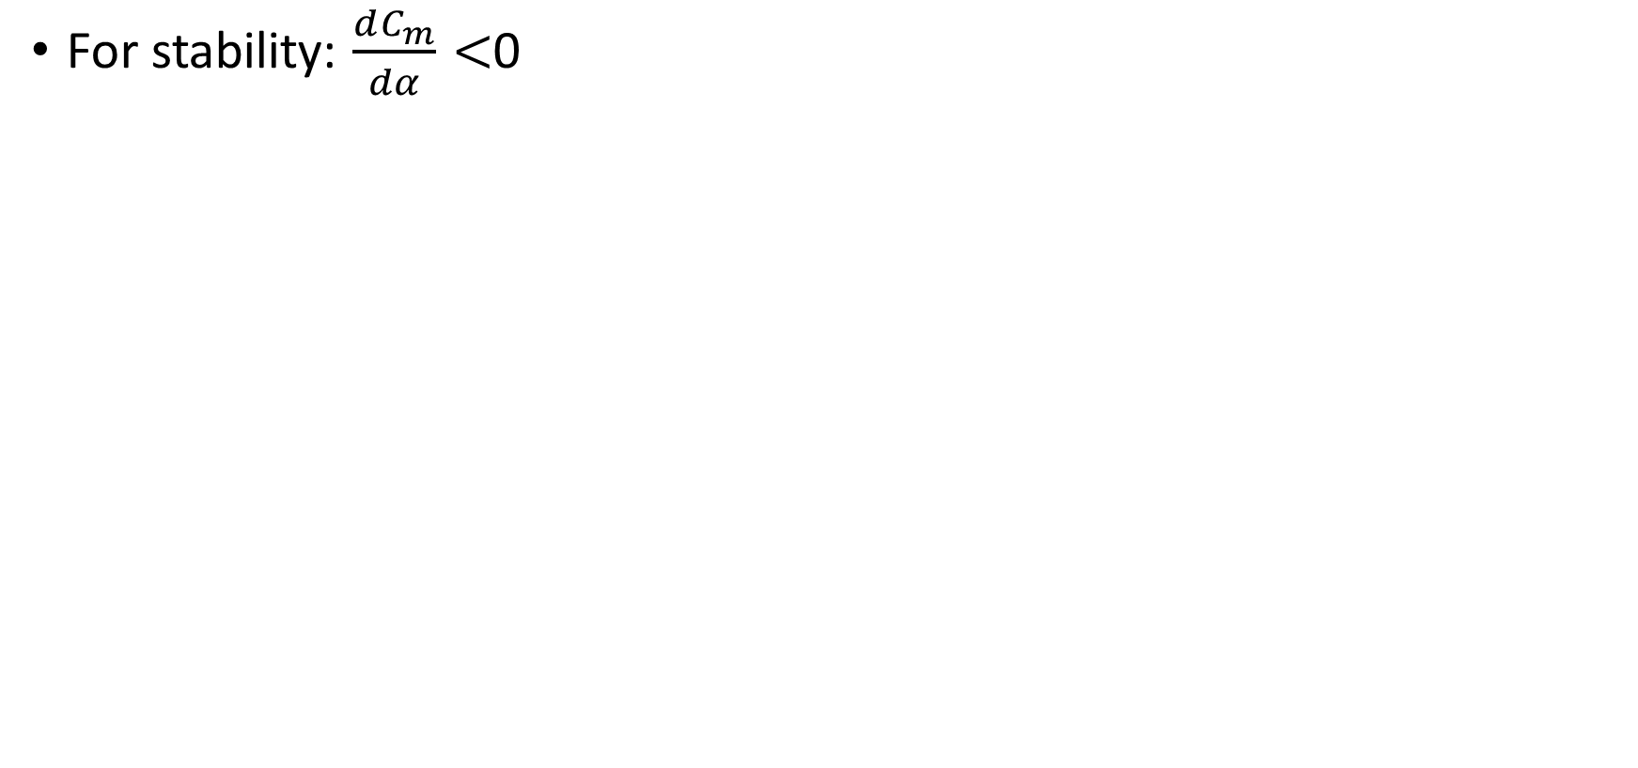
Investigating goals and requirements
For stability: $\frac{dC_{m}}{dα}<$0

Slide 14
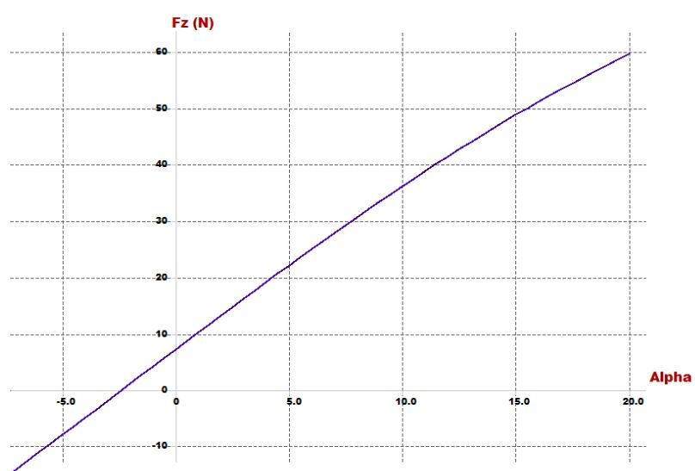
For lift: At trim angle the lift must carry the vehicle

Slide 15
Design parameters
In this part stability of quad-plane is checked and the airfoil design parameters (incidence angle, CG position, cruise speed and dimensions of wings) is chosen
Parameter | Effect on the vehicle
Span | proportional with lift
Chord | proportional with lift
Cruise speed | proportional with lift
Arm | Static stability
Incidence angle | Static stability
Position of CG | Static stability
Position of second wing | Static stability

Slide 16
Results

Slide 17
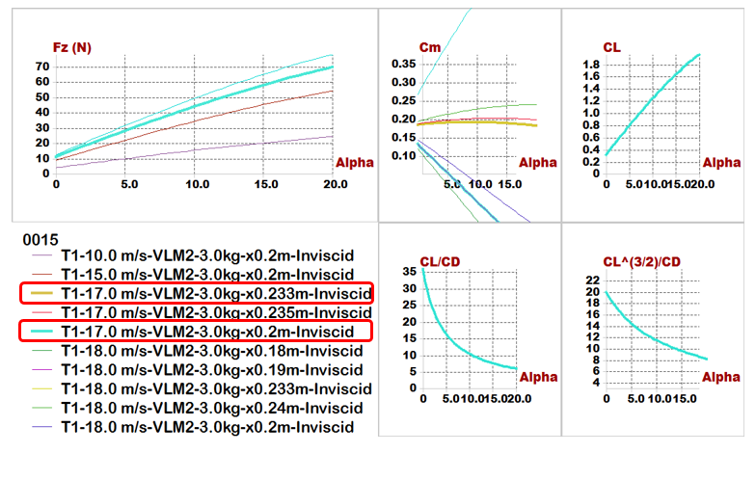
Plane analysis(NACA0015)

Slide 18
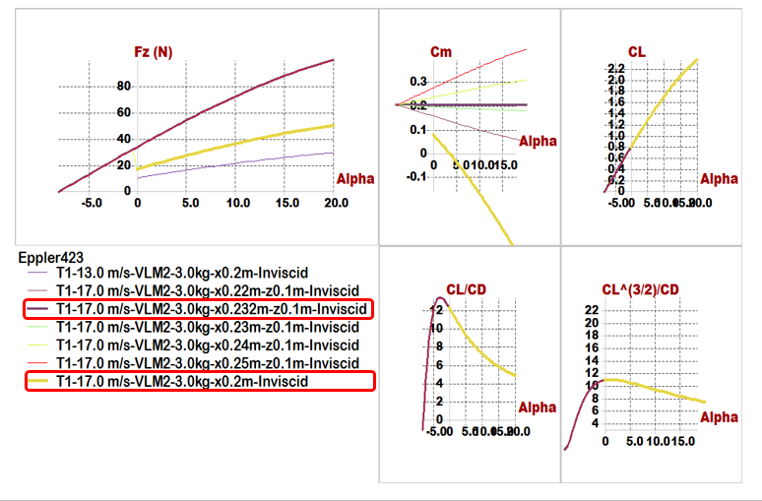
Plane analysis(Eppler423)

Slide 19
Quick comparison between 2 airfoils
Comparisons \ Models | Model 1 (NACA0015) | Model 2 (Eppler423)
Position of Main wing | x= 0, z= -0.05 m | x= 0, z= -0.05 m
Position of Second wing | x= 0.45 m, z= 0.1 m | x= 0.45 m, z= 0.15 m
Span | 0.8 m | 0.6 m
Chord | 0.25 m | 0.2 m
Aspect ratio | 3.2 | 3
Cruise speed | 17 m/s | 17 m/s
Incidence of Main wing | 5 degree | 3 degree
Incidence of Second wing | 2 degree | -8 degree
Trim angle | 5.1 degree | 3.6 degree
𝑿_𝑪.𝑮 | 0.19 m | 0.2 m
𝑿_𝑵.𝑷 | 0.233 m | 0.25 m
Degree of Static Stability (S.M.) | 17.2% | 25%

Slide 20
Optimization for aerodynamic stability

Slide 21
In this phase trying to put point of C.G. in the middle of the vehicle to equalize the value of moments resulting from two wings to optimize the (𝐶𝑚−𝛼) graph, PX4 requirements, easy to manufacturing and high accuracy results during assembly.
Parameter | Effect on the vehicle
Span | proportional with lift
Chord | proportional with lift
Cruise speed | proportional with lift
Arm | Static stability
Incidence angle | Static stability
Position of second wing | Static stability

Slide 22
Comparisons \ Models | Model (NACA0015)
Position of Main wing | x= 0 , z=0
Position of Second wing | x= 0.6 m , z= 0.3 m
Span of main wing | 0.6 m
Span of second wing | 0.75 m
Chord of main wing | 0.2 m
Chord of second wing | 0.22 m
Aspect ratio | 3.2
Cruise speed | 18 m/s
Incidence of Main wing | 3 degree
Incidence of Second wing | 2 degree
Trim angle | 6.7 degree
𝑿_𝑪.𝑮 | 0.36 m
Z_𝑪.𝑮 | 0.15 m
𝑿_𝑵.𝑷 | 0.383 m
Degree of Static Stability (S.M.) | 11.5%
Reylonds number | About (100,000 to 200,000)

Slide 23
Final Results

Slide 24
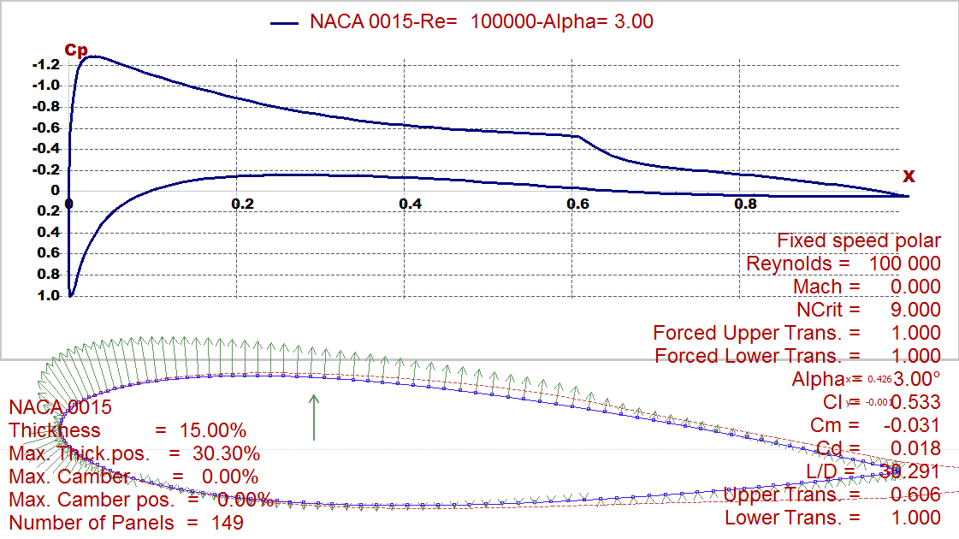
i. Foil characteristics

Slide 25
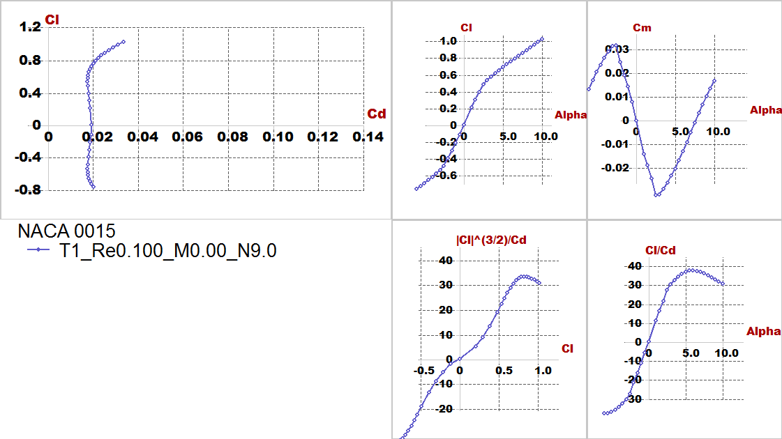

Slide 26
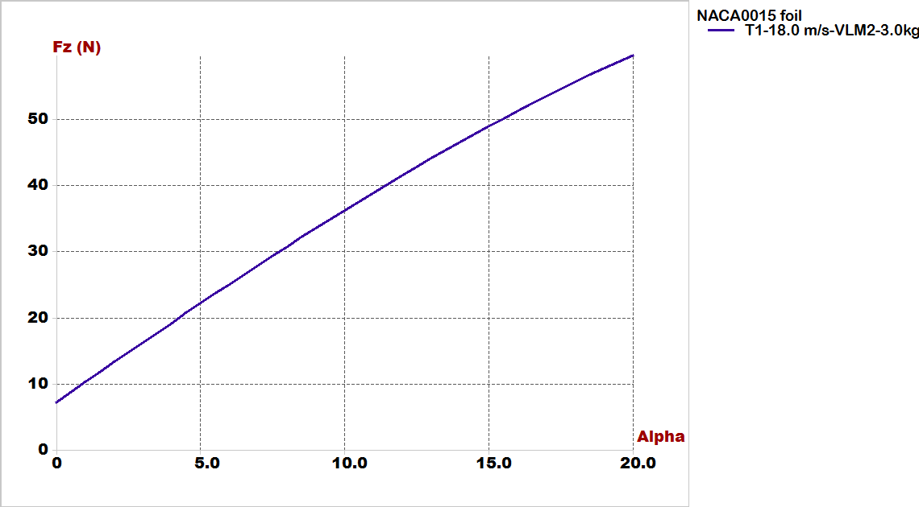
ii. Lift Vs alpha

Slide 27
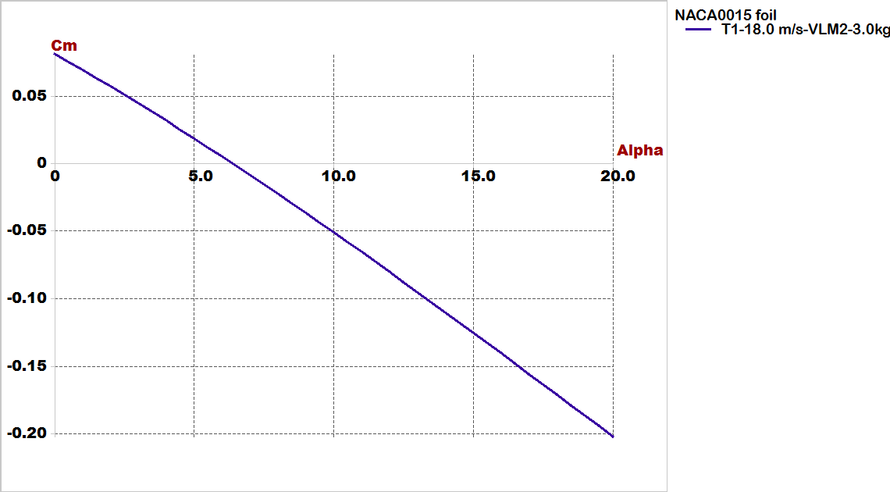
iii. Cm Vs alpha

Slide 28
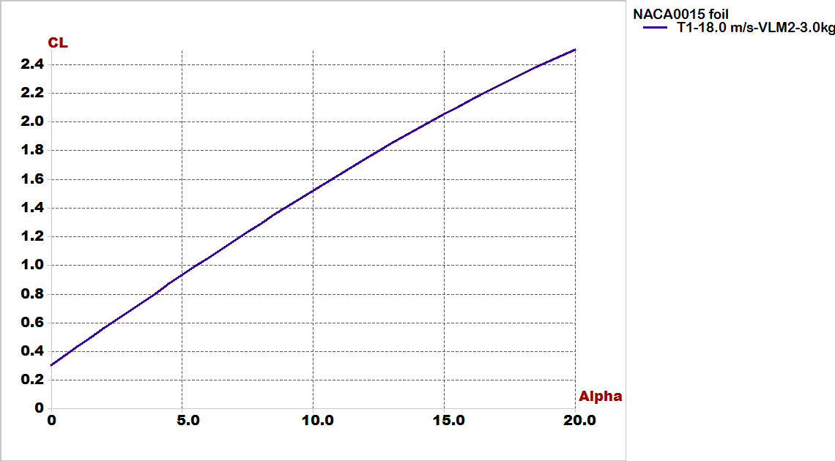
iv. Cl Vs alpha

Slide 29
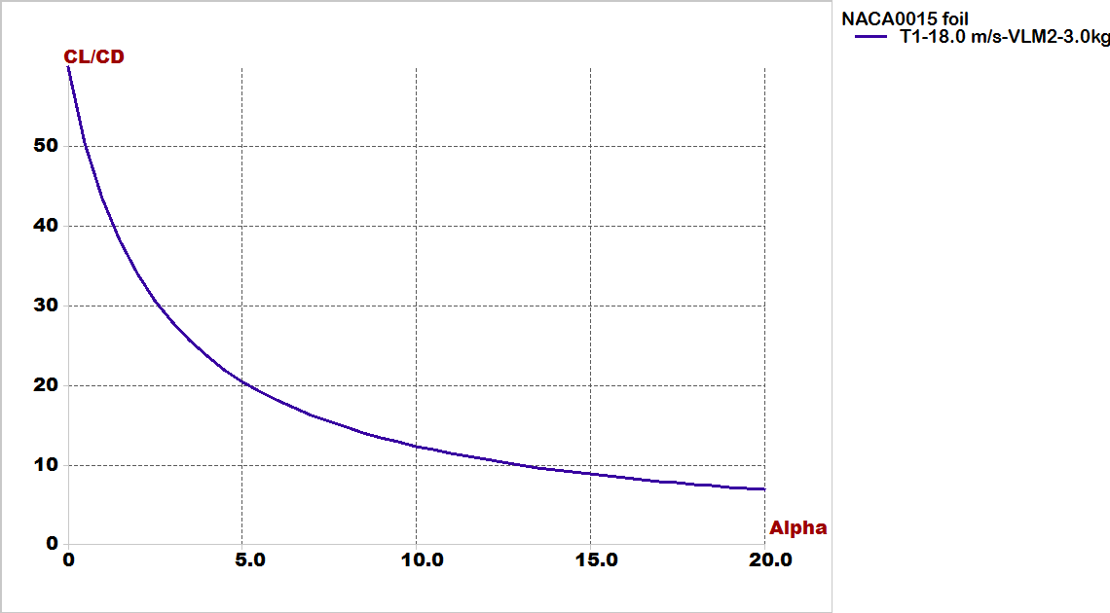
v. Cl/Cd Vs Cd:

Slide 30
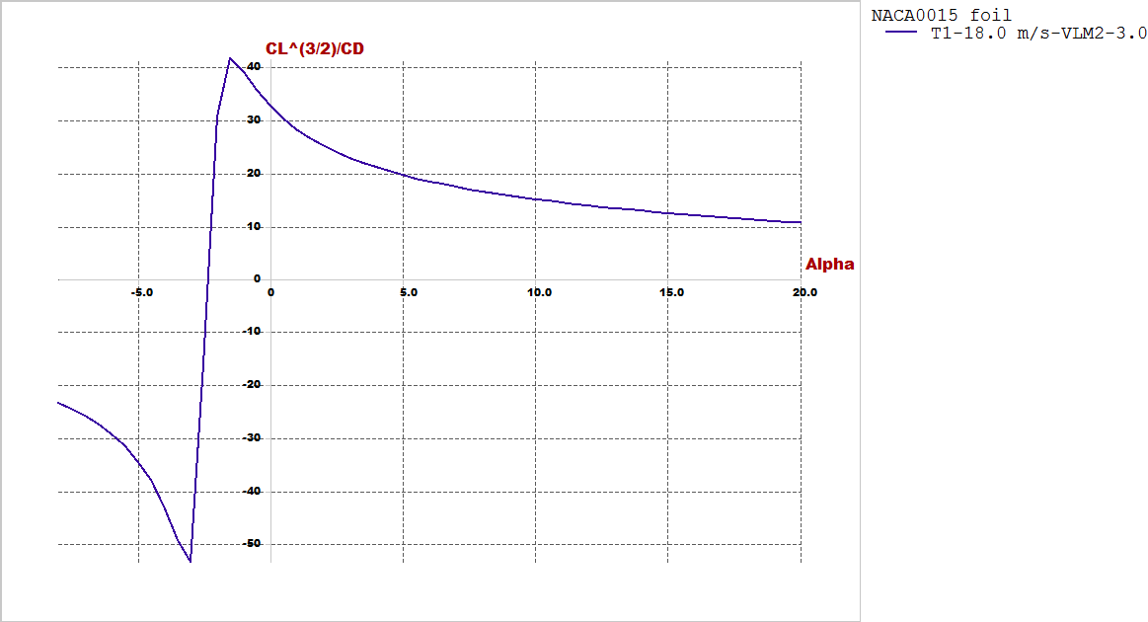
vi. Cl^(3/2)/Cd Vs alpha:

Slide 31
Stability Analysis

Slide 32
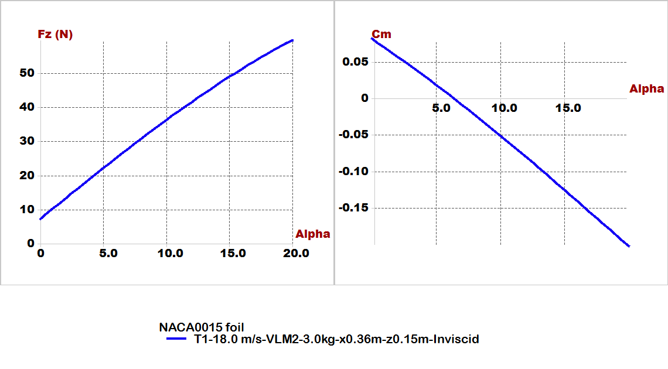
In experimental design checking for results very important by focus on 2 important figures:(longitudinal static stability and lift generated from airfoil)

Slide 33
Stability analysis:
We will illustrate this part by video its shown modes of longitudinal and lateral stability of plane by root locus and time response.
B. For lateral:
Type1: roll damping.
Type2,3: Dutch roll mode.
Type4: spiral mode.
For longitudinal:
Type1: short period mode.
Type2: Pitching.
Type3,4: motion around steady state flight.

Slide 34
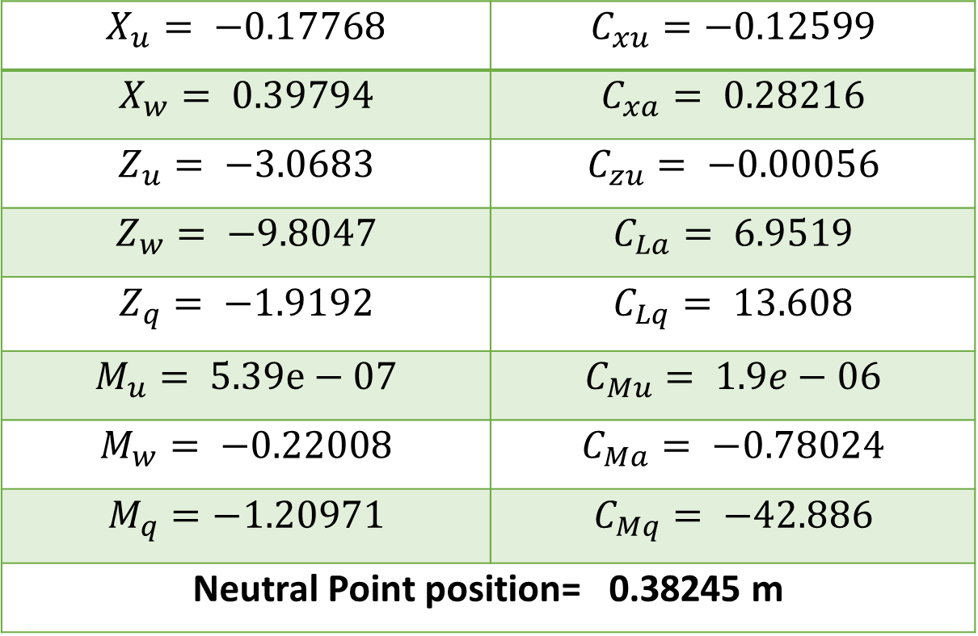
Longitudinal derivatives from Xflr5:
$$X_{u}= −0.17768$$ | $$C_{xu}=−0.12599$$
$$X_{w}= 0.39794$$ | $$C_{xa}= 0.28216$$
$$Z_{u}= −3.0683$$ | $$C_{zu}= −0.00056$$
$$Z_{w}= −9.8047$$ | $$C_{La}= 6.9519$$
$$Z_{q}= −1.9192$$ | $$C_{Lq}= 13.608$$
$$M_{u}= 5.39e−07$$ | $$C_{Mu}= 1.9e−06$$
$$M_{w}= −0.22008$$ | $$C_{Ma}= −0.78024$$
$$M_{q}=−1.20971$$ | $$C_{Mq}= −42.886$$
Neutral Point position= 0.38245 m

Slide 35
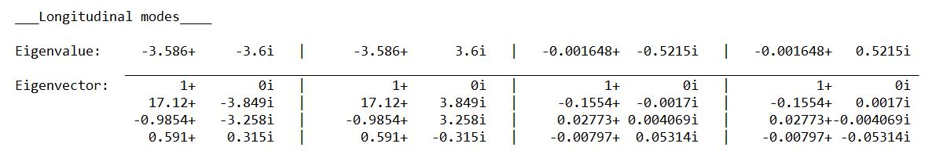
Root locus for longitudinal

Slide 36
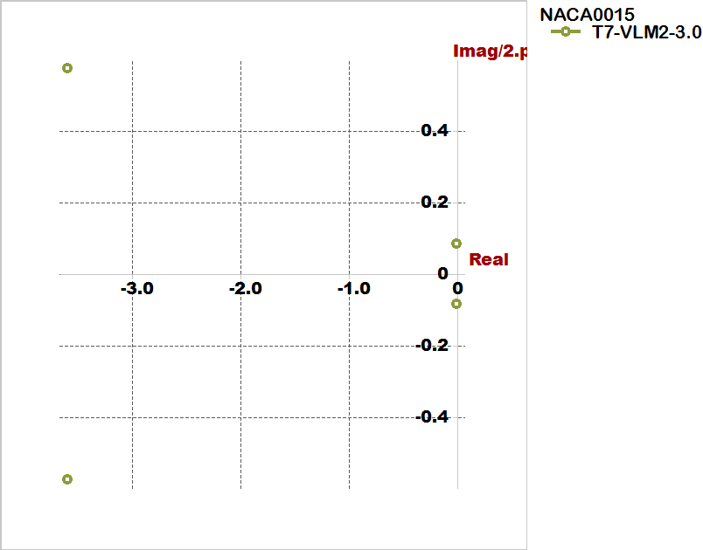

Slide 37
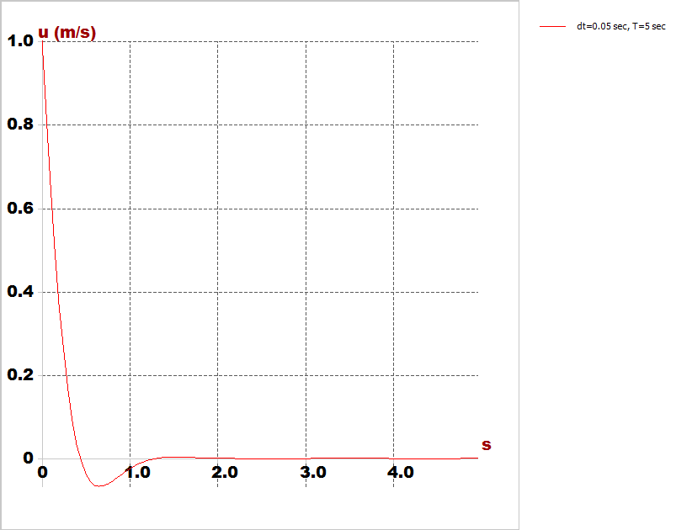
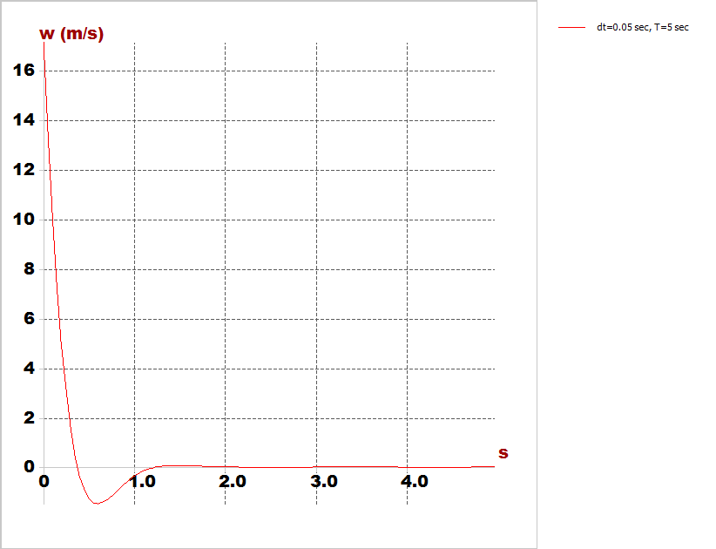
Time response characteristics
Horizontal speed response
Vertical speed response

Slide 38
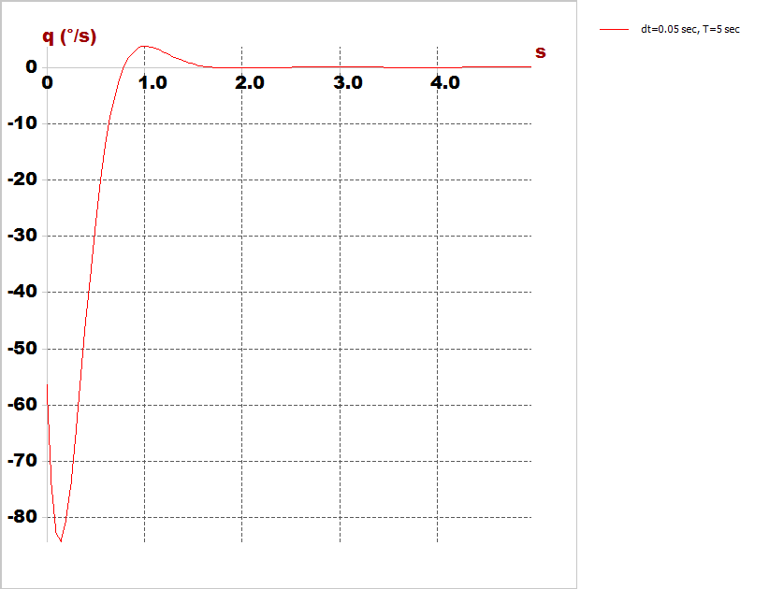
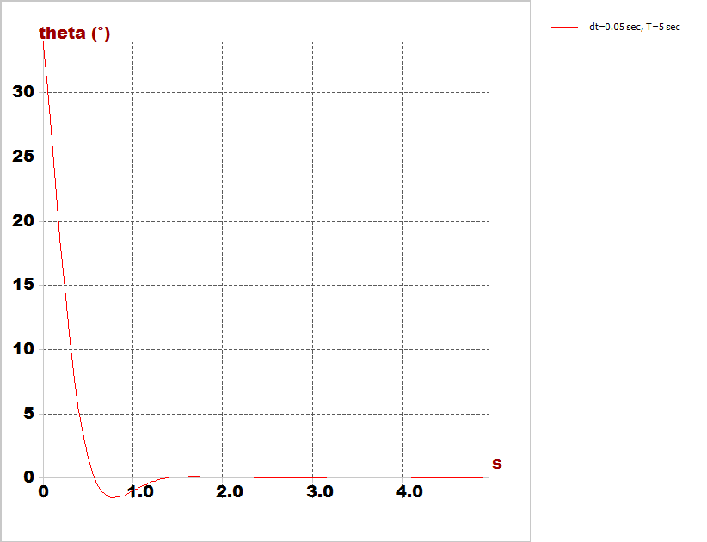
Time response characteristics
Pitch rate
Pitch angle

Slide 39
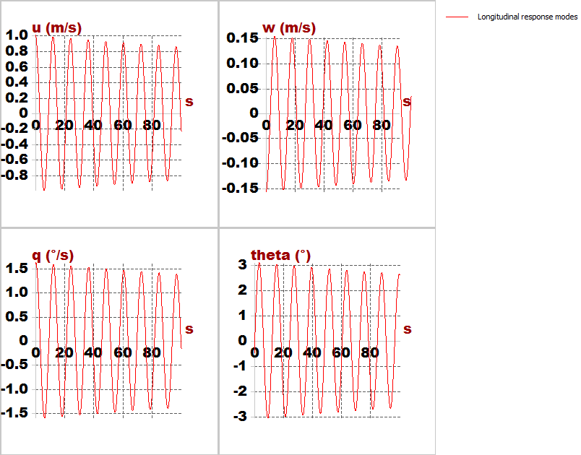
Time response characteristics

Slide 40
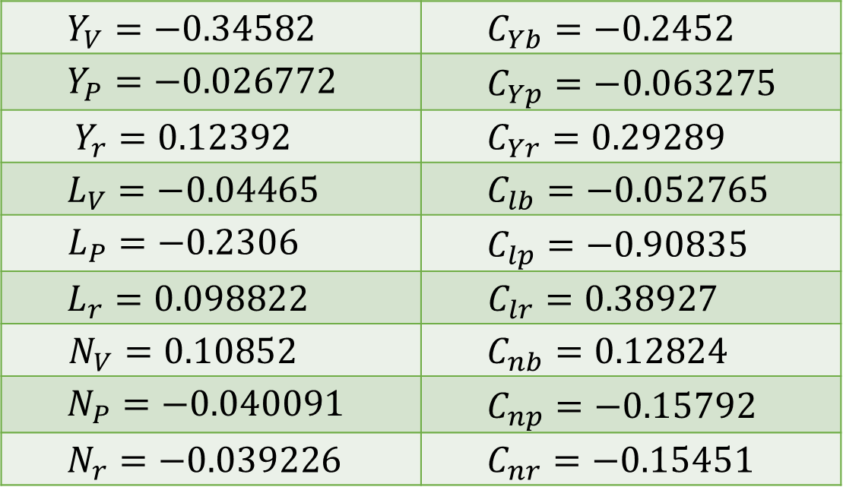
Lateral derivatives from Xflr5
$$Y_{V}=−0.34582$$ | $$C_{Yb}=−0.2452$$
$$Y_{P}=−0.026772$$ | $$C_{Yp}=−0.063275$$
$$Y_{r}=0.12392$$ | $$C_{Yr}=0.29289$$
$$L_{V}=−0.04465$$ | $$C_{lb}=−0.052765$$
$$L_{P}=−0.2306$$ | $$C_{lp}=−0.90835$$
$$L_{r}=0.098822$$ | $$C_{lr}=0.38927$$
$$N_{V}=0.10852$$ | $$C_{nb}=0.12824$$
$$N_{P}=−0.040091$$ | $$C_{np}=−0.15792$$
$$N_{r}=−0.039226$$ | $$C_{nr}=−0.15451$$

Slide 41
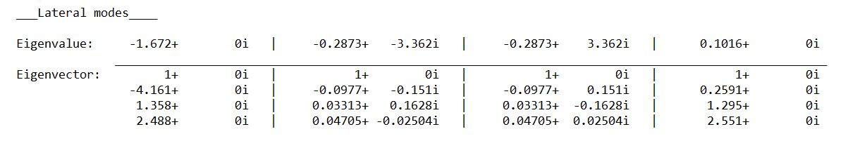
Root locus for lateral

Slide 42
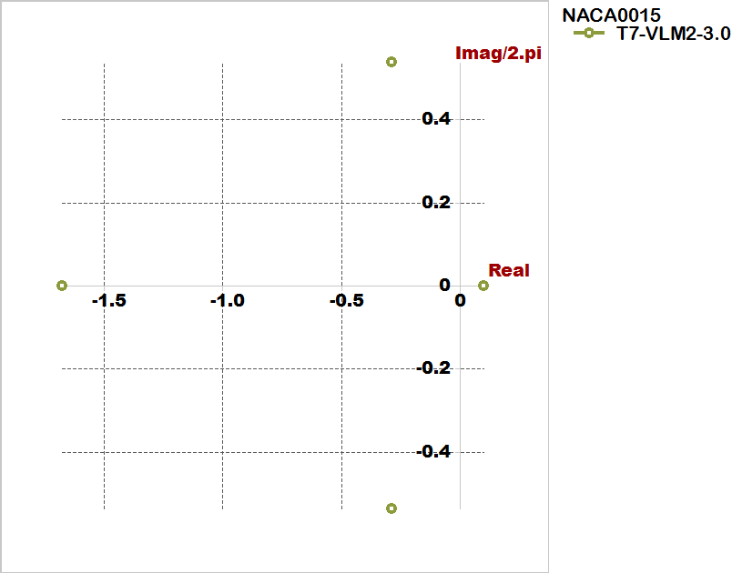

Slide 43
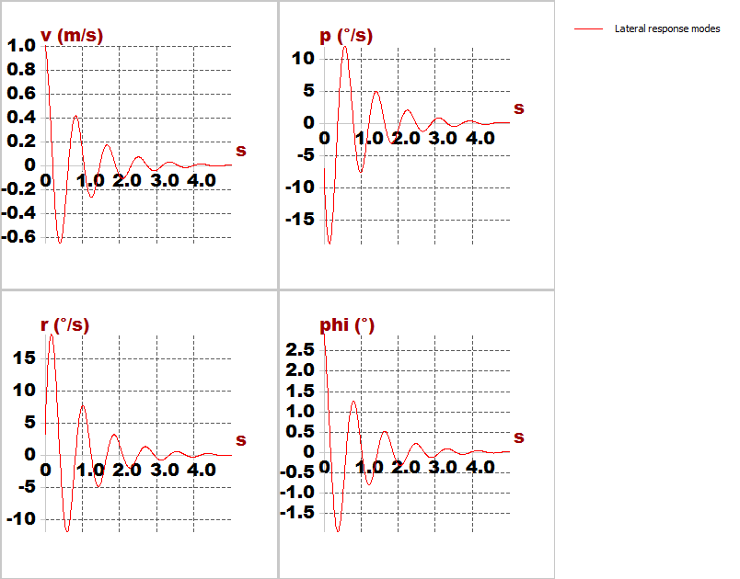
Time response characteristics

Slide 44
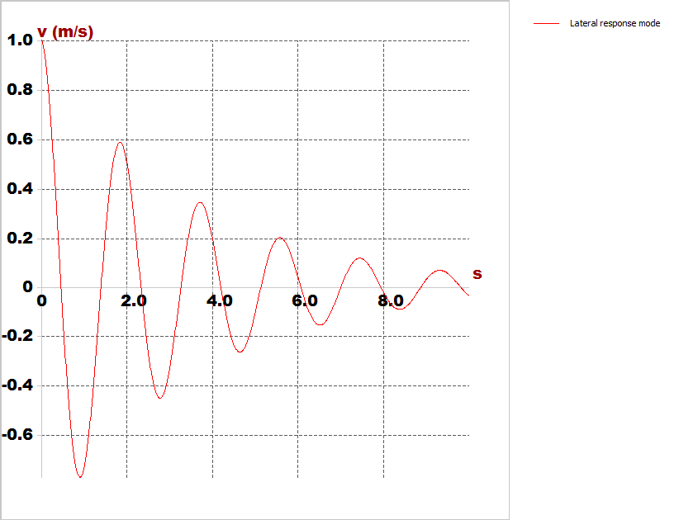
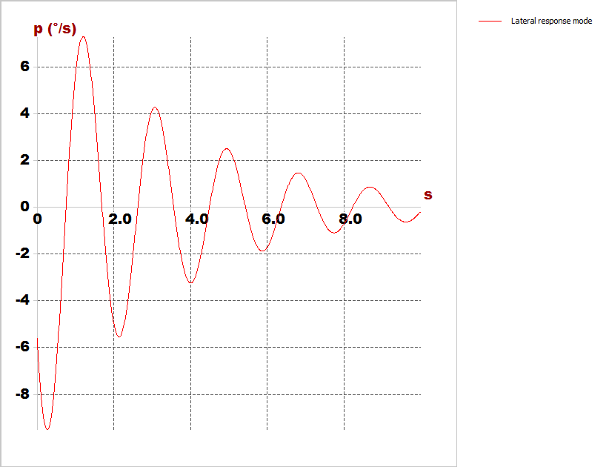
Time response characteristics
Cruise speed
Roll rate

Slide 45
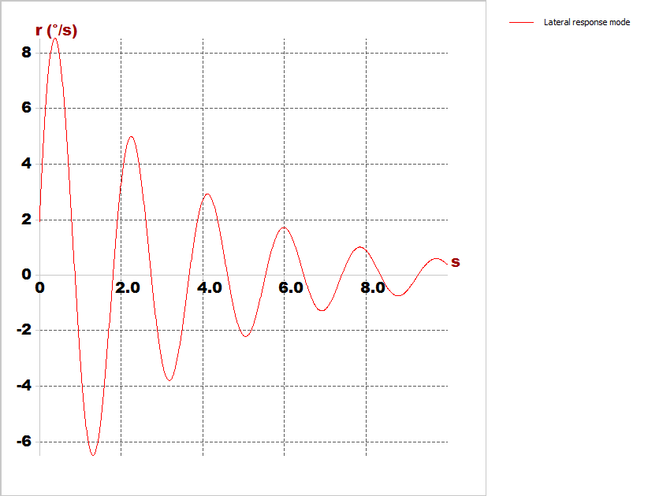
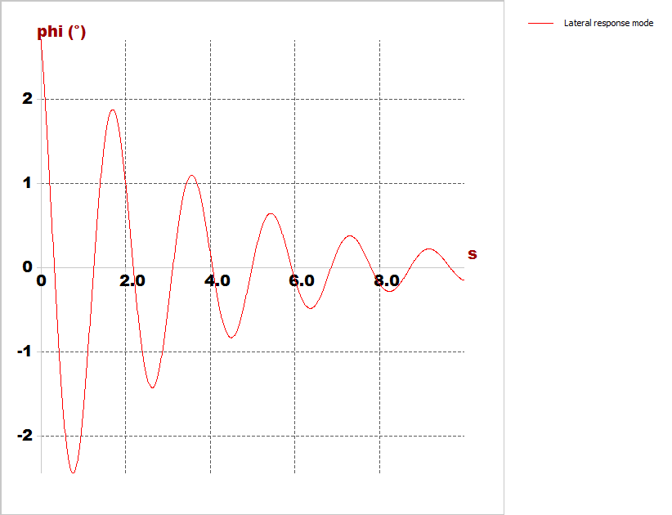
Time response characteristics
Yaw rate
Bank angle

Slide 46
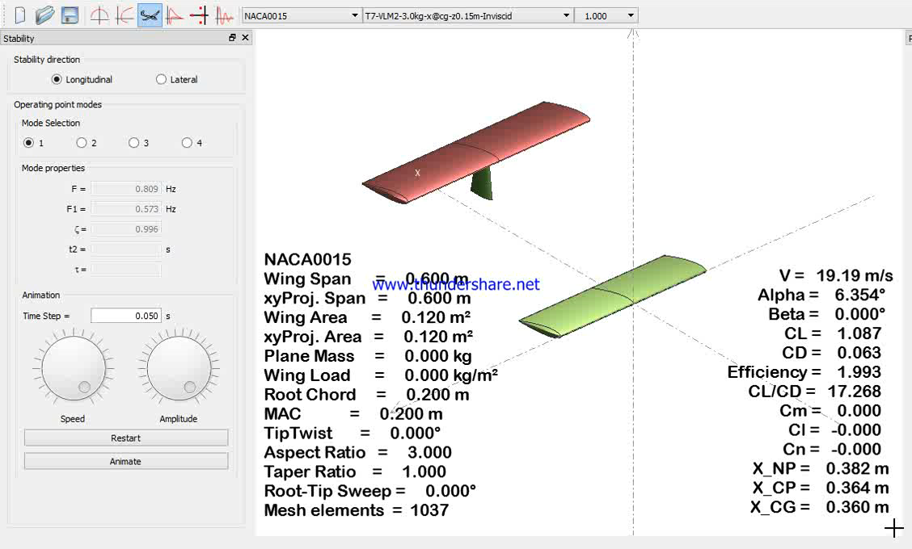
Longitudinal simulation

Slide 47
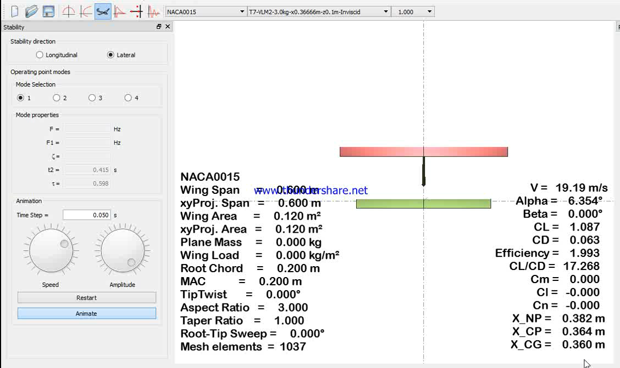
Lateral simulation

